Slide 1
Relational Database Design
Lecture 7

Slide 2

What is Normalization?
Eliminating or reducing redundancy in relations.
Why is redundancy created in DB?
When 2 or more independent relations are stored in a single relation
Eg. if EMPLOYEE and DEPARTMENT
relations are stored as a single relation

Slide 3
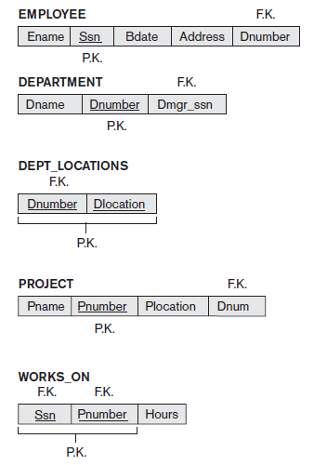
COMPANY Database

Slide 4
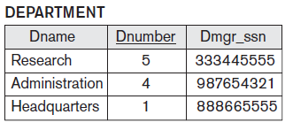
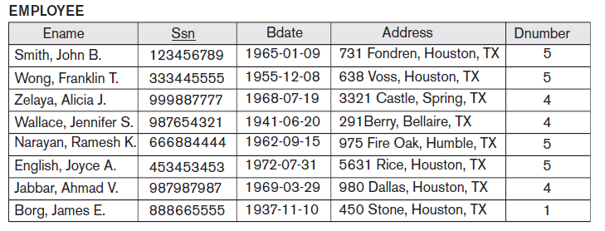
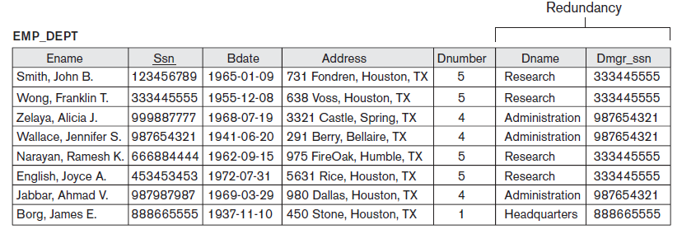
Why Redundancy?
2 independent relations combined

Slide 5
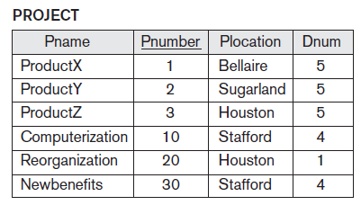
Problems Encountered due to Redundancy
Update Anomaly:

Slide 6
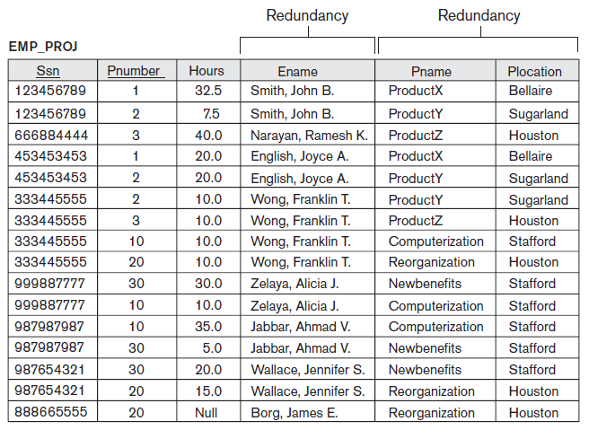
Update Anomaly (Cont.)
2 independent relations combined
Changing the name of project number “30” from “Newbenefits” to “Customer-Accounting” may cause this update to be made for all employees working on project “30”.

Slide 7
Problems Encountered due to Redundancy
Cannot insert a project unless an employee is assigned to it.
If we still want to insert a project, the employee details will be filled by dummy data which causes inconsistency
Insertion Anomaly:

Slide 8
Problems Encountered due to Redundancy
If a project is deleted, consequently all the employees who work on that project will be deleted. Thus, loosing employee information.
Deletion Anomaly:

Slide 9

Guidelines for Normalized DB
Attributes of different entities should not be mixed in the same relation and only foreign keys should be used to refer to other entities.
Design a schema that does not suffer from the insertion, deletion and update anomalies.
The relations should be designed to satisfy the lossless join condition. No spurious tuples should be generated by doing a natural-join of any relations.
Relations should be designed such that their tuples will have as few NULL values as possible Attributes that are NULL frequently could be placed in separate relations.

Slide 10



Solution of Redundancy

Slide 11
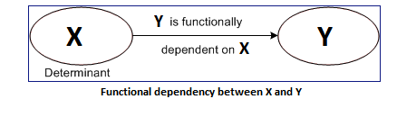
Functional Dependency
If one set of attributes in a table determines another set of attributes in the table, then the second set of attributes is said to be functionally dependent on the first set of attributes.
FDs are constraints that are derived from the meaning and interrelationships of the data attributes

Slide 12
Functional Dependencies (Cont.)
A set of attributes X functionally determines a set of attributes Y if the value of X determines a unique value for Y.
X → Y holds if whenever two tuples have the same value for X, they must have the same value for Y.
For any two tuples t1 and t2 in any relation:
If t1[X] = t2[X], then t1[Y] = t2[Y]
X → Y in R specifies a constraint on all relation instances r(R)

Slide 13

Examples of FD
social security number determines employee name
SSN → ENAME
project number determines project name and location
PNUMBER → {PNAME, PLOCATION}
employee ssn and project number determines the hours per week that the employee works on the project
{SSN, PNUMBER} → HOURS

Slide 14
Functional Dependencies (Cont.)
If K is a key of R,
then K functionally determines all attributes in R
since, two distinct tuples with t1[K]=t2[K] not possible
SSN → ENAME
SSN → BDATE
SSN → ADDRESS
SSN → DNUMBER

Slide 15
Examples of FD
Table Scheme: {PubID, PubName, PubPhone}
Functional Dependencies:
{PubId} → {PubPhone}
{PubId} → {PubName}
{PubName, PubPhone} → {PubID}
Table Scheme: {AuID, AuName, AuPhone}
Functional Dependencies:
{AuId} → {AuPhone}
{AuId} → {AuName}
{AuName, AuPhone} → {AuID}
PubId | PubName | PubPhone
1 | Big House | 123-456-7890
2 | Small House | 999-456-7890
3 | Alpha Press | 111-111-7890
AuId | AuName | AuPhone
1 | Sleepy | 999-456-9999
2 | Snoopy | 999-456-1111
3 | Grumpy | 111-111-7890
4 | Jones | 222-222-2222
5 | Smith | 333-333-3333
6 | Joyce | 444-444-4444
7 | Snoopy | 555-555-5555

Slide 16
FD Categorization
Functional Dependency
Trivial FD
Semi Non-trivial FD
- If a functional dependency (FD) X → Y holds, where Y is a subset of X, then it is called a trivial FD.
- Trivial FDs always hold.
- Eg. Ssn Ename → Ename
- Combination of trivial and non-trivial FD.
- Eg. Ssn → Ssn Sname
ie. Ssn → Ssn
Ssn → Sname
Non-trivial FD
- If an FD X → Y holds, where Y is not a subset of X, then it is called a non-trivial FD.
- Eg. Ssn → Ename

Slide 17
FD Important Note
Trivial FD are always implied but non-trivial FD can be implied/not implied.
A relation with no non-trivial FD is also possible.
Example:
A FD is implied/not implied is decided on the basis on data.
Trivial/non-trivial FD is decided on the basis of attributes.
A → B B → A AB → C
A → C B → C BC → A
A→ BC B → AC AC → B
None of the above non-trivial FDs are implied. Thus, the candidate key for this relation is ABC
A | B | C
3 | 4 | 2
3 | 4 | 3
3 | 6 | 2
3 | 6 | 3
4 | 4 | 2

Slide 18

Inference Rules for FDs
Armstrong's inference rules:
IR1. Reflexive: If Y subset-of X, then X → Y
IR2. Augmentation: If X → Y, then XZ → YZ
IR3. Transitive: If X → Y and Y → Z, then X → Z

Slide 19
Inference Rules for FDs (Cont.)
Additional Inference Rules:
IR4. Decomposition If X → YZ, then X → Y and X → Z
IR5. Union: If X → Y and X → Z, then X → YZ
IR6. Psuedotransitivity: If X → Y and WY → Z,
then WX → Z

Slide 20
Attribute Closure [X⁺]
[X⁺] = set of all attributes that are functionally determined by X
Relation F = {Ssn → Ename, Pnumber → {Pname, Plocation}, {Ssn, Pnumber} → Hours}
{Ssn} + = {Ssn, Ename}
{Pnumber} + = {Pnumber, Pname, Plocation}
{Ssn, Pnumber} + = {Ssn, Pnumber, Ename, Pname, Plocation, Hours}

Slide 21

Attribute Closure Drill 1
Relation R(name, color, category, department, price)
name → color
category → department color
category → price
Compute name+ , {name, category}+ , {color}+

Slide 22

Solution Drill 1
Closures:
name+ = {name, color}
{name, category}+ = {name, category, color, department, price}
color+ = {color}

Slide 23

Attribute Closure Drill 2
R(A,B,C,D,E,F,G)
A → BC
BC → DE
D → F
CF → G
Compute A+, D+, BC+

Slide 24
Solution Drill 2
A⁺ = { A }
= { A , B , C } ( Using A → BC )
= { A , B , C , D , E } ( Using BC → DE )
= { A , B , C , D , E , F } ( Using D → F )
= { A , B , C , D , E , F , G } ( Using CF → G )
Thus,
A⁺ = { A , B , C , D , E , F , G }
D⁺ = { D }
= { D , F } ( Using D → F )
Thus,
D⁺ = { D , F }
{ B , C }⁺= { B , C }
= { B , C , D , E } ( Using BC → DE )
= { B , C , D , E , F } ( Using D → F )
= { B , C , D , E , F , G } ( Using CF → G )
Thus,
{ B , C }⁺ = { B , C , D , E , F , G }

Slide 25

Superkey
Let R be the relational schema and X be the some attribute set over R
X is superkey of R iff X+ determines all attributes of R
i.e. X+ = {all attributes of R}

Slide 26
Superkey Example
Relation R(A,B,C,D,E)
FD = { AB → C, C → D, B → E}
(AB+) = { A, B, C, D, E } Thus, AB is superkey
(ABC+) = { A, B, C, D, E } Thus, ABC is superkey
(ABCDE+) = { A, B, C, D, E } Thus, ABCDE is superkey
(BC+) = { B, C, D, E } Thus, BC is not superkey

Slide 27
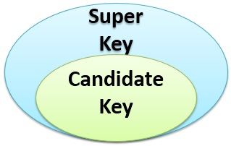
Candidate Key: Minimal Superkey
X is candidate key of R if and only if
X is superkey of R and
No proper subset of X is superkey

Slide 28
Candidate Key Example
Relation R = (ABCDE),
F = {A → C, E → D, B → C}
A+ = AC
B+ = BC
C+ = C
D+ = D
E+ = DE
ABE+ = ABCDE Thus, candidate key is ABE
Any attribute that only appears on the right side in a trivial dependency must be in the candidate key. For this, that includes ABE.

Slide 29
Candidate Key (Cont.)
If a relation schema has more than one key, each is called a candidate key. One of the candidate keys is arbitrarily designated to be the primary key, and the others are called secondary keys.
Prime Attribute: member of some candidate key
Non-prime Attribute: not a member of any candidate key.

Slide 30

How to Check for Multiple Candidate keys?
If X → Y is a non-trivial FD in relation R with Y as a prime attribute, then R has atleast 2 candidate keys
Example: R ( X, Y, P…..) & X → Y is one of the FD
(YP)+ = {all attributes} Thus, YP is candidate key and Y is prime attribute
(XP)+ = {X, P, Y, remaining all attributes because of YP}
∴ XP is another candidate key
X
Y
Prime attribute

Slide 31

Candidate Key Drill
Find candidate key
R = ABCDE, F = {A → BE, C → BE, B → D}
R = ABCDEF, F = {A → B, B → D, C → D, E → F}
R = ABCD, F={AB → C, BC → D, CD → A}
R = {A, B, C, D, E} F = {A → BC, CD → E, B → D, E → A}

Slide 32
Solution Candidate Key Drill
R = ABCDE, F = {A → BE, C → BE, B → D}
A+ = ABDE
B+ = BD
C+ = CBDE
D+ = D
E+ = E
R = ABCDEF, F = {A → B, B → D, C → D, E → F}
A+ = ABD
B+ = BD
C+ = CD
D+ = D
E+ = EF
ACE+ = ABCDEF
Thus, AC is candidate key
Thus, ACE is a candidate key.

Slide 33
Solution Candidate Key Drill
R = ABCD, F={AB → C, BC → D, CD → A}
AB+ = ABCD
BC+=ABCD
CD+=ACD
BCD+ = ABCD
R = {A, B, C, D, E} F = {A → BC, CD → E, B → D, E → A}
A+ = ABCDE B+ = BD C+ = C D+ = D
E+ = ABCDE AB+ = ABCDE AC+ = ABCDE AD+ = ABCDE
AE+ = ABCDE BC+ = ABCDE BD+ = BD BE → ABCDE
CD → ABCDE CE → ABCDE DE → ABCDE ABC → ABCDE
ABD → ABCDE ABE → ABCDE ACD → ABCDE ACE → ABCDE
ADE → ABCDE BCD → ABCDE BDE → ABCDE CDE → ABCDE ABCD → ABCDE ABCE → ABCDE ABDE → ABCDE ACDE → ABCDE
BCDE → ABCDE
Thus, AB and BC are candidate key. BCD is not candidate key as it is not minimal
Thus, A, E, CD, BC are candidate key.

Slide 34

FD Membership Test
Let F be the FD set with FD X → Y
FD X → Y is implied in F iff
X+ determines Y in FD set F
i.e. FD X → Y is implied in F iff X+ = {…..Y…..}

Slide 35
FD Membership Test Example
Relation R ( A, B, C, D)
Is AB → D a member of F = { AB → C, BC → D}?
AB+ = ABCD ∴ AB → D is a member of F.
Relation R ( A, B, C, D)
Is C → AB a member of F = { AB → C, C → D, D → A}?
C+ = { C, D, A} ∴ C → A is implied but C → B is not implied
∴ C → AB is not a member of F

Slide 36

Equivalence of FD Sets
Two sets of FDs F and G are equivalent if:
- every FD in F is implied in G, and
- every FD in G is implied in F
Definition:
F covers G (F ⊇ G) if every FD in G is implied in F.
Similarly, G covers F (G ⊇ F) if every FD in F in implied in G.
F and G are equivalent if F covers G and G covers F

Slide 37
Equivalence of FD Sets Example
Consider the following two sets of FDs
F= {A → C, AC → D, E → AD, E → H}
G = {A → CD, E → AH}
Check whether or not they are equivalent.
Solution
Proof that G is covered by F:
{A} + = {A, C, D} (with respect to F), which covers A →CD in G
{E} + = {E, A, D, H, C} (with respect to F), which covers E →AH in G
Proof that F is covered by G:
{A} + = {A, C, D} (with respect to G), which covers A → C in F
{A, C} + = {A, C, D} (with respect to G), which covers AC →D in F
{E} + = {E, A, H, C, D} (with respect to G), which covers E → AD and E → H in F

Slide 38

Equivalence of FD Sets Drill
1. A relation R (A , C , D , E , H) is having two functional dependencies sets F and G as shown-
F = { A → C, AC → D, E → AD, E → H}
G = { A → CD, E → H}
Check if F and G are equivalent?
2. Are these two FD sets equivalent or not?
FD1 = {AB → C, D → E, E → C}
FD2 = { AB → C, D → E, AB → E, E → C}

Slide 39

Solution Equivalence of FD Sets Drill
1. Determining whether F covers G-
(A)⁺ = { A , C , D } // using set F
(E)⁺ = { A , C , D , E , H } // using set F
Thus, we conclude F covers G i.e. F ⊇ G
Determining whether G covers F-
(A)⁺ = { A , C , D } // using set G
(AC)⁺ = { A , C , D } // using set G
(E)⁺ = { E , H } // using set G
Thus, we conclude G does not cover F
∴ F ≠ G

Slide 40

Solution Equivalence of FD Sets Drill
2. FD2 covers FD 1
FD1 does not cover FD 2 as AB → E is not implied in FD 1.
Thus, FD1 ≠ FD2

Slide 41

Practice Question
Ques: Relation R has eight attributes ABCDEFGH. Fields of R contain only atomic values.
F = { CH → G, A → BC, B → CFH, E → A, F → EG}
is a set of functional dependencies (FDs)
How many candidate keys does the
relation R have?

Slide 42
Solution
A+ = ABCEFGH which is all attributes except D.
B+ = ABCEFGH which is all attributes except D.
E+ = ABCEFGH which is all attributes except D.
F+ = ABCEFGH which is all attributes except D.
So, there are total 4 candidate keys AD, BD, ED and FD

Slide 43
Practice Question
Consider a relation with schema R(A,B,C,D)
FDs are {AB → C, C → D, D → A}.
What are some of the nontrivial FDs that can be inferred from the given FDs?
What are all candidate keys of R?

Slide 44
Solution
Some of the non-trivial FDs:
C → ACD D → AD AB → ABCD
AC → ACD BC → ABCD BD → ABCD
CD → ACD ABC → ABCD ABD → ABCD
BCD → ABCD
Attribute Closure:
A → A B → B C → ACD D -→ AD
AB → ABCD AC → ACD AD → AD BC → ABCD
BD → ABCD CD → ACD ABC → ABCD
ABD → ABCD ACD → ACD BCD → ABCD
Thus, candidate keys are: AB, BC, and BD

Slide 45
Thanks!!

